Slide 1
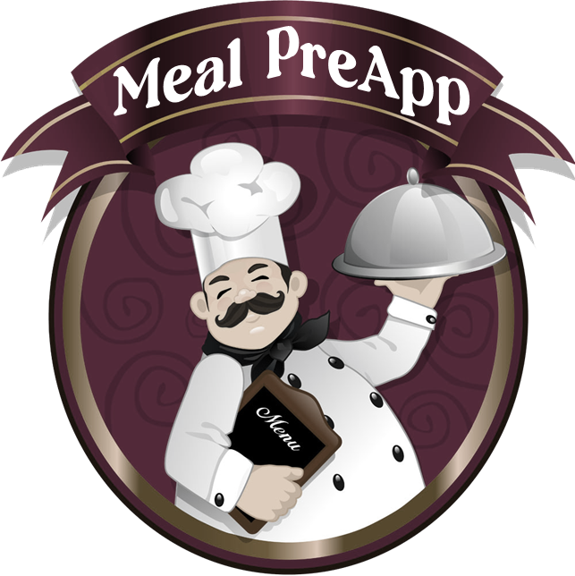
| Chema Hernández | Eva Longoria | Enrique Schwanke |

Slide 2

Meal PreApp
Introducing an innovative web application that empowers meal lovers to unleash their creativity and experiment with a diverse range of recipes.
From simple ingredients to exquisite culinary masterpieces, this platform offers a thrilling opportunity to craft awe-inspiring plates, pushing the boundaries of culinary artistry.
From breakfast to dinner, and everything in between, our app has recipes that can't be beat!
Notes:
Elevator Pitch

Slide 3



Concept & Process
Our coding project aims to develop a dynamic web app that empowers users to explore and discover new recipes, try new ingredients, cooking techniques, and cuisines allowing them to expand their culinary horizons and encouraging creativity in the kitchen by leveraging information gathered from popular websites like Edamam and Spoonacular.
The key objectives of our coding project include:
Creating a responsive and visually appealing web app using HTML, JavaScript, and Bulma as the front-end framework.
Implementing API calls to fetch recipe data and display it dynamically on our app.
Incorporating interactive features, such as search functionality, filtering options, and modals, to enhance the user experience.
This project will be carried out by a collaborative team, actively working together to achieve our common goal. We will apply the concepts and techniques learned during our bootcamp classes to create a functional and user-friendly web app. Each team member will contribute their unique skills and expertise to ensure the success of the project.

Slide 4


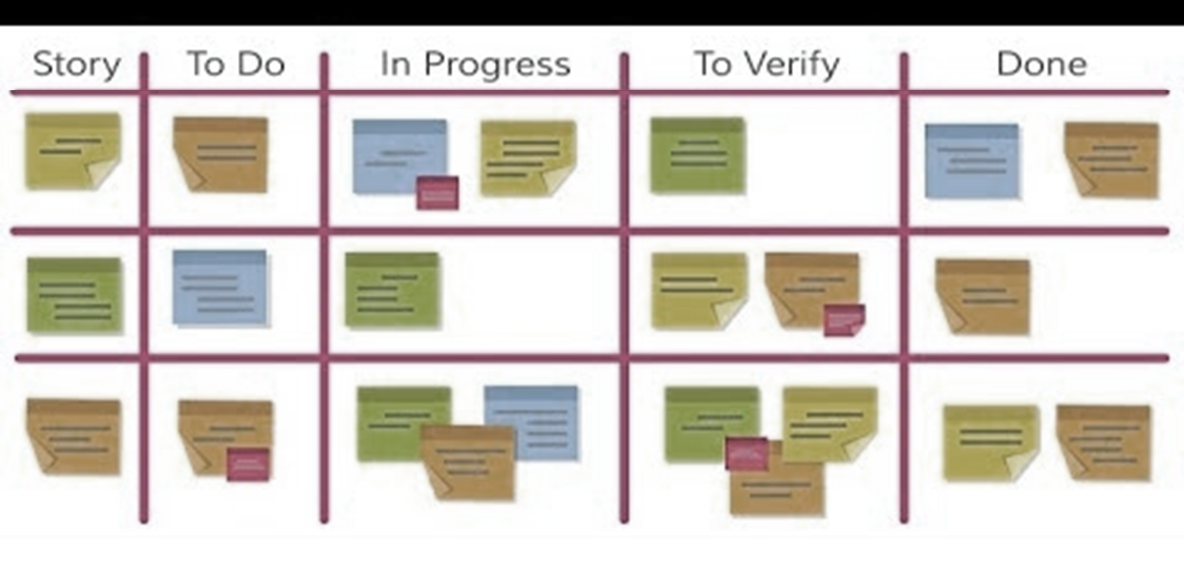
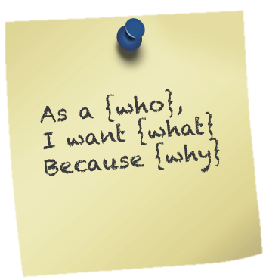
User Story
AS A
.
food enthusiast willing to cook
.
an app that will allow me to create new dishes, experimenting with diverse flavors in my daily routine and that is adaptable to my ingredient, nutritional, and cuisine type needs
.
I can cook smartly, impress my guests with my culinary prowess, and elevate my cooking expertise to new heights.
I NEED
SO THAT

Slide 5








WBS
Project Planning
Define project objectives and scope
Identify team roles and responsibilities
Create project schedule and timeline
Research and Design
Identify user needs and preferences
Create user personas and develop use cases
Define app features and functionalities
Design user interface (UI)
Create wireframes and mockups
Front-end Development
Develop HTML, CSS, and JavaScript code for the app's front-end
Implement responsive design for different devices and screen sizes
Create interactive elements such as forms, buttons, and navigation
Incorporate design elements and graphics
Back-end Development
Develop server-side logic and APIs
Implement local storage functionality for storing and retrieving recipes and user data
Test and debug server-side functionality
Testing and Quality Assurance
Conduct testing of the app's functionalities, features, and UI
Identify and fix any bugs, errors, or inconsistencies
Verify compatibility with different web browsers and devices
Deployment and Launch
Prepare the app for production deployment
Deploy the app to Github
Conduct final testing and quality checks before app launch
Create project presentation

Slide 6

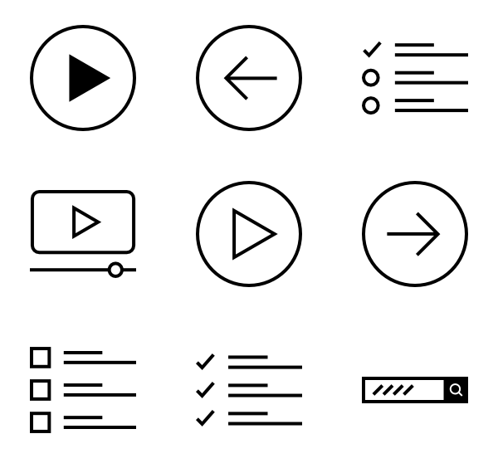


Wireframe
Aa
Aa
Submit

Slide 7

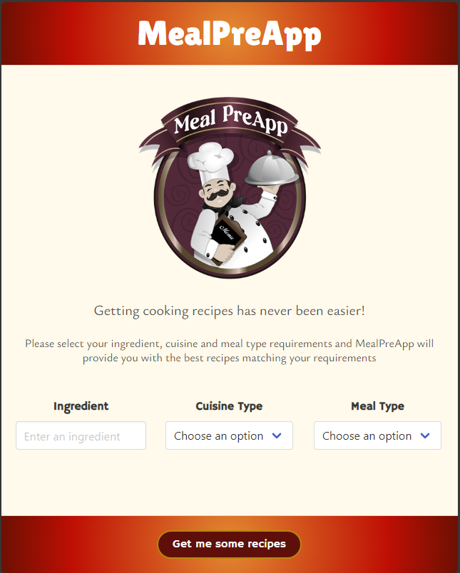
Demo

Slide 8

Future Deployment
.
Links to cooking videos explaining the recipe procedures
.
Translate the page and recipe results to different languages
Nutritional Facts for the whole recipe instead of just the main ingredient
.
Adding more requirement criteria for better search results

Slide 9


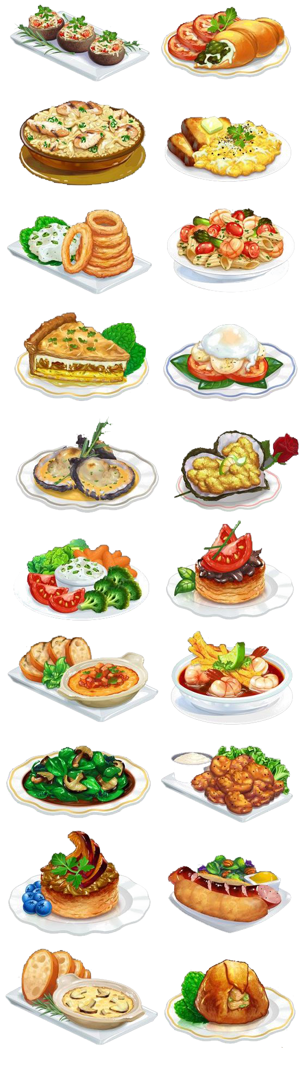





API Calls & Links
Edamam Recipe API
USDA Food Data Central API
GitHub Repo
GitHub Pages

